Slide 1
The role of infrastructure and logistics in local development
Paolo Bisogni
ELA president
November 5th 2017

Slide 2
Executive summary
The role of infrastructure and logistics in local development
As population become more and more urbanized worldwide, physical distribution is becoming more and more undistinguishable from city distribution. Electronic commerce and customer expectation push towards shorter delivery times while ever growing environmental concern prompts supply chain managers at finding leaner and greener logistics solutions.
Available evidence suggests that there is a positive correlation between supply chain competences and the development of transport infrastructure, while spillover effects of infrastructure investment confirm the need for a sophisticated, managerial and systematic approach.

Slide 3

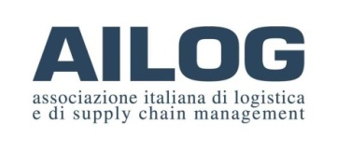


First things first
Paolo Bisogni
Management consultant
President of AILOG, Italian Logistics Association
President of ELA, European Logistics Association
Professor of Supply Chain Management
at Catholic University of Milan

Slide 4
About ELA
International not for profit organization
Established in 1984
European Federation of National Logistics Associations
Covering most of the European countries
Reaching about 50.000 logistics professionals

Slide 5
Members
Austria
Belarus
Belgium (2)
Caribbeans
Croatia
Czech Republic
Cyprus
Finland
France
Germany (2)
Greece
Hungary
Ireland
Italy
Kazakhstan
Lithuania
Luxemburg
Netherlands
Morocco
Poland (2)
Portugal
Romania
Russia
Slovenia
Spain (2)
Sweden
Switzerland
United Kingdom

Slide 6
Mission
ELA aims to provide an international forum for networking, promotion and development of the logistics and supply chain profession.

Slide 7
Achieving this by
Being a European ‘focal point’ for logisticians
European Supply Chain Day
ELA Awards
ELA Standards and certification
EU Connection

Slide 8


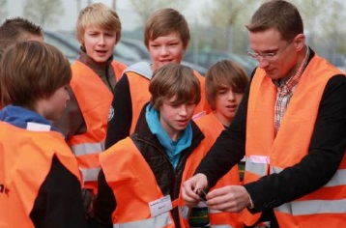
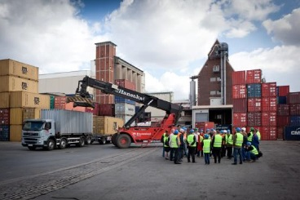
European Supply Chain Day
World wide
Promote the profession
www.supply-chain-day.com

Slide 9

ELA Awards
Champion League system
  National Award winner compete
International Jury
  Different disciplines within logistics
Best practice
International exposer
  Winning projects are presented during national conferences of member associations

Slide 10
EUROLOG
Annual event
  9 to 11 May 2018, Marrakesh Morocco
Collaboration with and support from different member associations
International visibility
ELA Supply Chain Talents day (bi-annual)

Slide 11

ELA Certification
Qualification system for logistics professionals
Based on ELAQF Qualification Standards agreed by the industry
Reflects expectations of workspace performance
Global mark of competence
Local assessment by National Certification Centres
Using EQF – European Qualification Framework

Slide 12
ELA Certification available in
Austria
Belgium
Bulgaria
Croatia
Czech Republic
Egypt
Finland
France
Germany
Greece
Indonesia
Italy
Mexico
Netherlands
Portugal
Poland
Romania
Russian Federation
South Africa
Spain
Sweden
Switzerland
United Kingdom

Slide 13
ELA Standards
Recognised by Industry
Used as logistics standards by the World Bank Group
  LPI
  Funded projects
European Investment Bank projects use ELA standards and Certification in their deliverables
European Reconstruction and Development Bank prefers ELA Standards and Certification in their project
United Nations have realised several project including ELA Certification

Slide 14
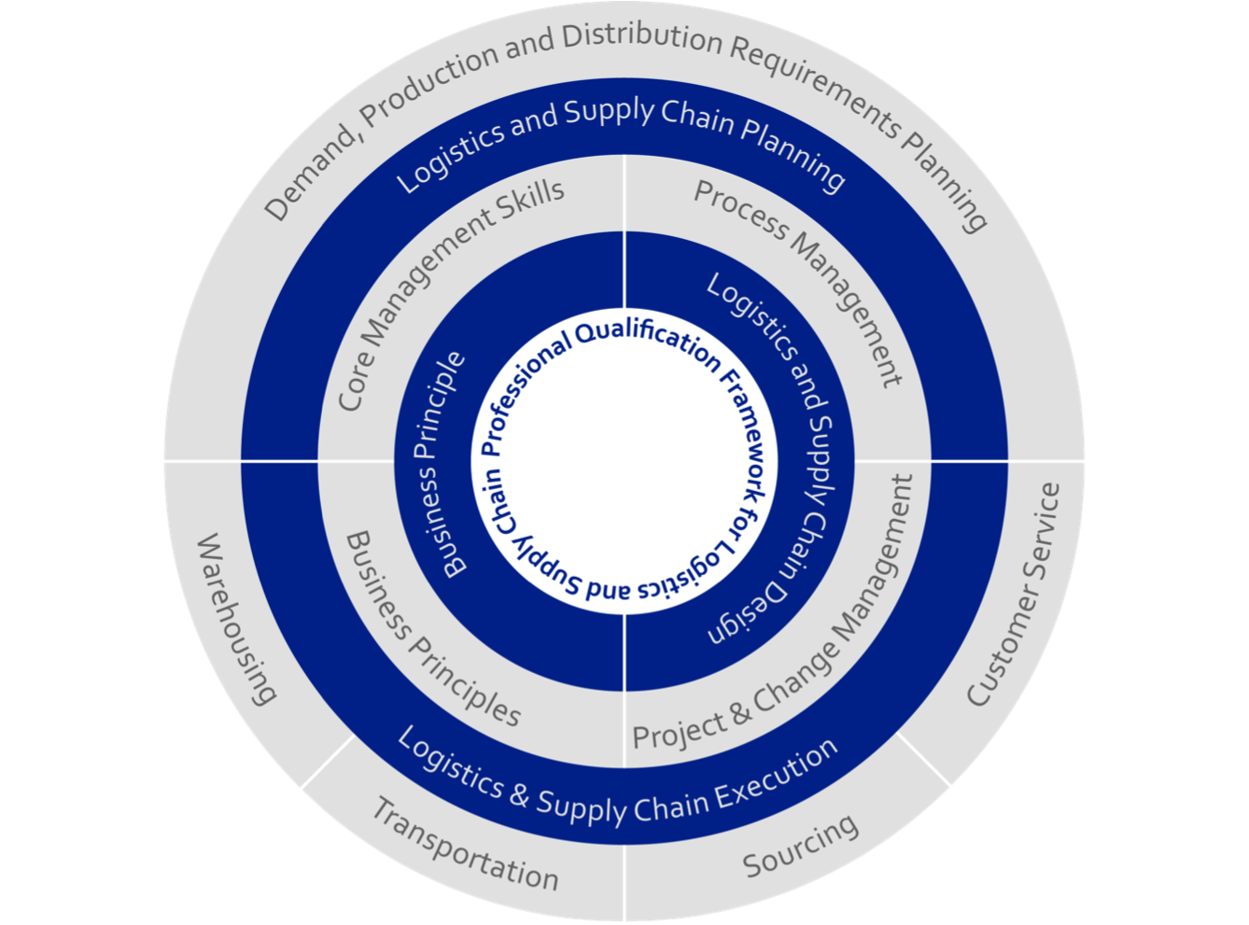
ELA Certification Levels
EJLog
  European Junior Logistician meeting the professional standards at the Supervisory/Operational management level
ESLog
  European Senior Logistician meeting the professional standards at the Senior management level
EMLog
  European Master Logistician meeting the professional standards at the Strategic management level

Slide 15


Preliminary remark: logistics is becoming ever more urban

Slide 16
Preliminary remark: logistics is becoming ever more urban
Some important trends:
Urbanization rate is growing
e-commerce is growing
Service expectations: availability and short delivery times
Growth of share economy
Environmental sustainability

Slide 17
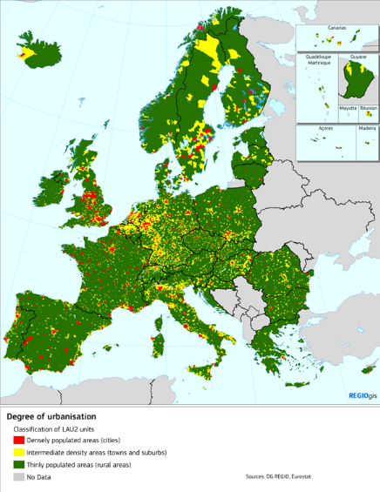
Preliminary remark: logistics is becoming ever more urban
Some important trends:
Urbanization rate is growing,
Italy
  urban population: 69.3% of total population (2017)
  rate of urbanization: 0.32% annual rate of change (2015-20 est.)
Iran
  urban population: 74.4% of total population (2017)
  rate of urbanization: 1.78% annual rate of change (2015-20 est.)

Slide 18
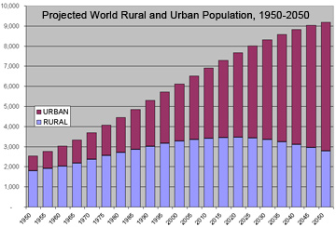
Preliminary remark: logistics is becoming ever more urban
Some important trends:
Urbanization rate is growing

Slide 19
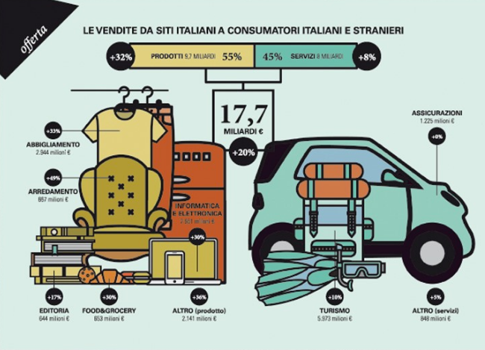
Preliminary remark: logistics is becoming ever more urban
Some important trends:
e-commerce is growing
(source: Osservatori Digital Innovation School of Management Politecnico di Milano)

Slide 20
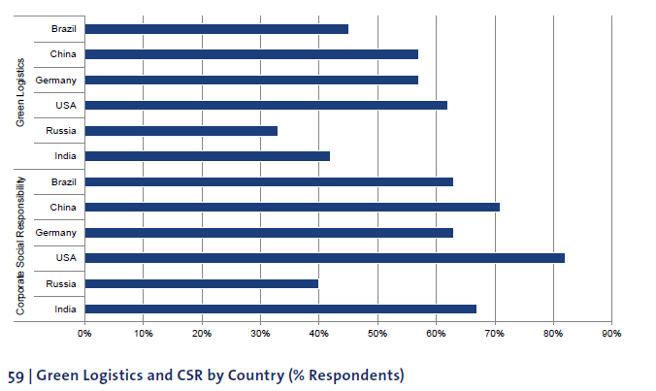
Preliminary remark: logistics is becoming ever more urban
Some important trends:
Environmental Sustainability
BVL Trends and Strategies in Logistics and Supply Chain Management

Slide 21
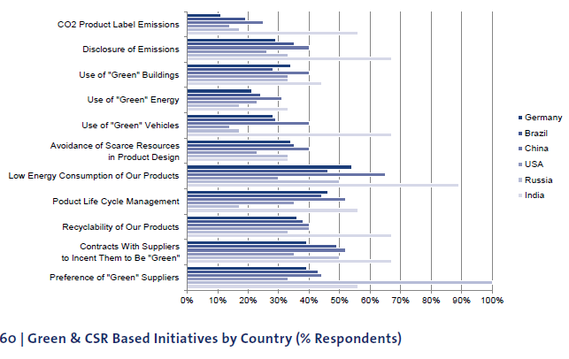
Preliminary remark: logistics is becoming ever more urban
Some important trends:
Environmental Sustainability
BVL Trends and Strategies in Logistics and Supply Chain Management

Slide 22
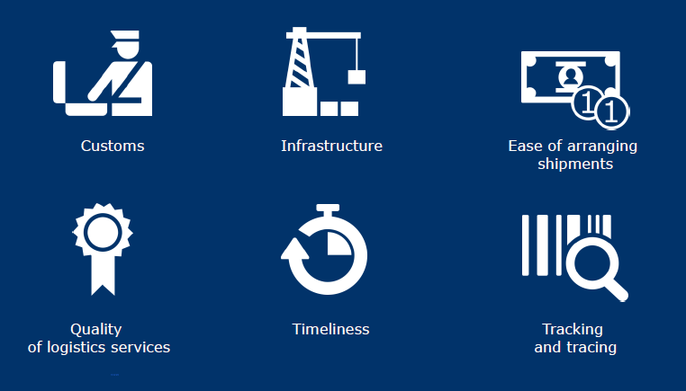
Logistic Performance Index (LPI)
The LPI is an interactive benchmarking tool created by the World Bank to help countries identify the challenges and opportunities they face in their performance on trade logistics and what they can do to improve their performance. It provides a qualitative evaluations of a country in six areas on a scale from 1 to 5

Slide 23
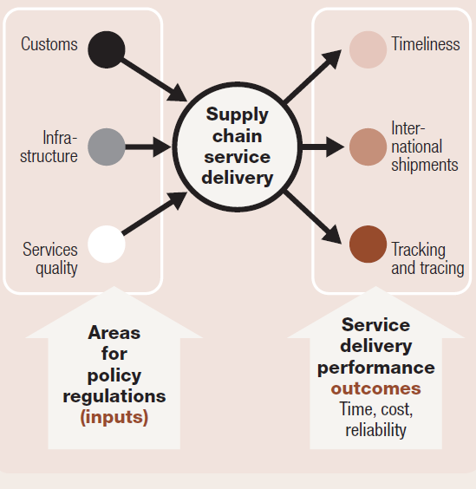
The Logistic Performance Index (LPI)
The LPI 2016 allows for comparisons across 160 countries. The LPI is based on a worldwide survey of operators on the ground (global freight forwarders and express carriers), providing feedback on the logistics “friendliness” of the countries in which they operate and those with which they trade.
The six areas include both input factors affecting logistic performances and results or outcomes

Slide 24
The Logistic Performance Index (LPI)
The components analyzed in the International LPI were chosen based on recent theoretical and empirical research and on the practical experience of logistics professionals involved in international freight forwarding. They are:
The efficiency of customs and border management clearance (“Customs”)
The quality of trade and transport infrastructure (“Infrastructure”)
The ease of arranging competitively priced shipments (“Ease of arranging shipments”)
The competence and quality of logistics services—trucking, forwarding, and customs brokerage (“Quality of logistics services”)
The ability to track and trace consignments (“Tracking and tracing”)
The frequency with which shipments reach consignees within scheduled or expected delivery times (“Timeliness”)

Slide 25
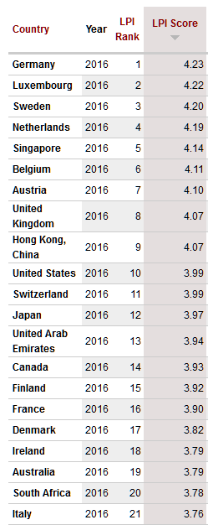
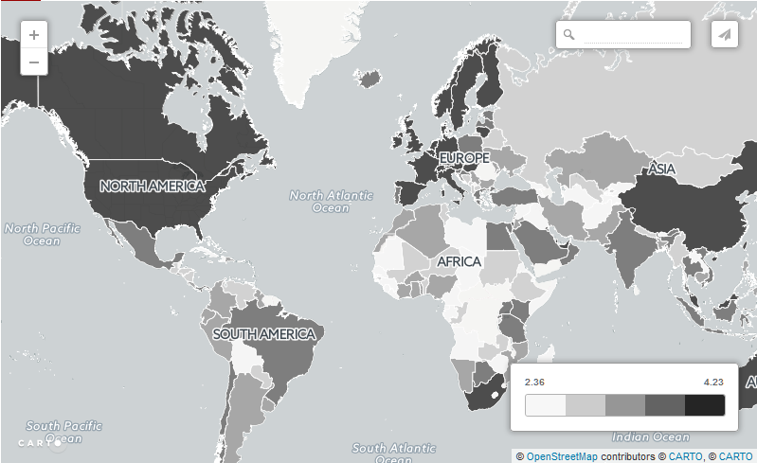
The Logistic Performance Index (LPI)
Nonostante la posizione geografica favorevole, l’Italia si posiziona al 21° posto della classifica mondiale, dopo la Germania, i Paesi Bassi ed altri 12 paesi europei.
Source: The World Bank, Logistic Performance Index 2016

Slide 26
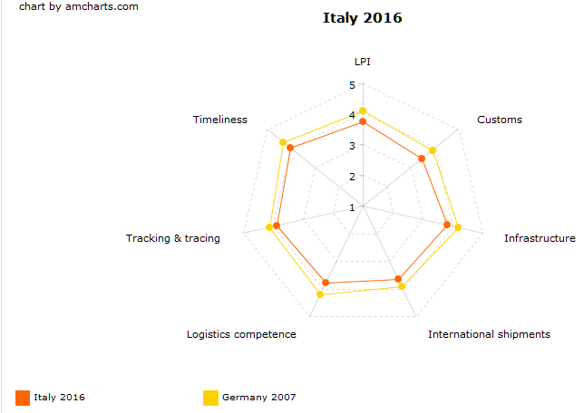
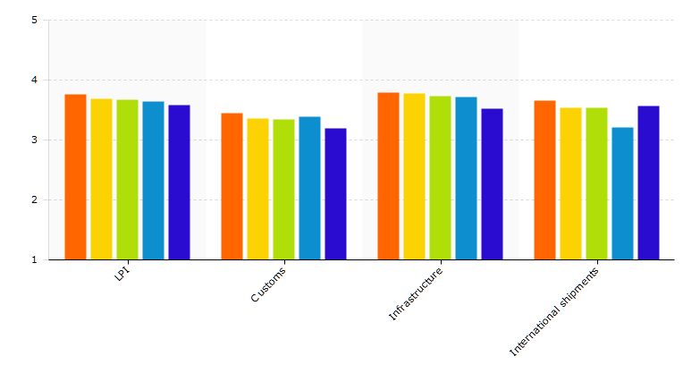
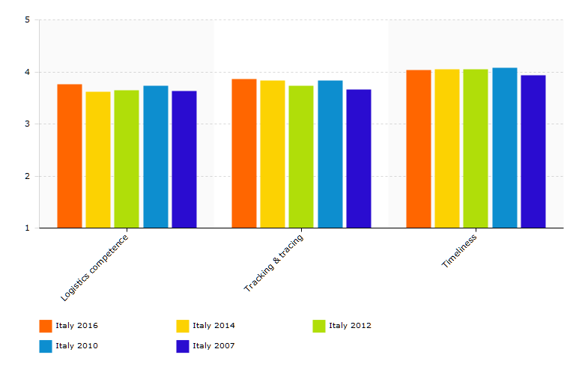
The Logistic Performance Index (LPI): Italy
LPI storico
In comparison to the best performer (Germany), Italy shows lower values for all indexes of the LPI
Nevertheless, italian LPI has been growing since 2007
Source: The World Bank, Logistic Performance Index 2016

Slide 27
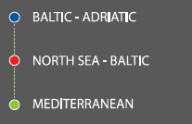
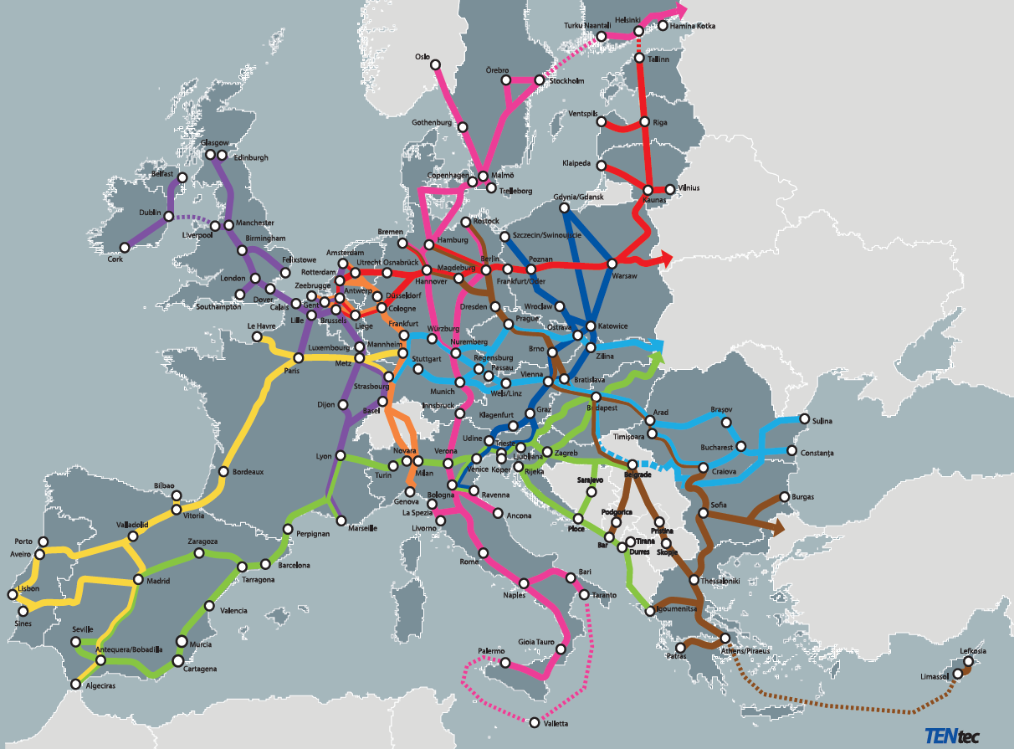
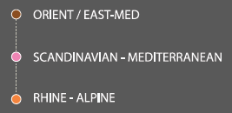
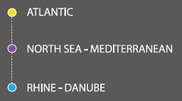
TEN-T Corridors in the European Union
BALTIC - ADRIATIC
NORTH SEA - BALTIC
MEDITERRANEAN
ORIENT/EAST - MED
SCANDINAVIAN - MEDITERRANEAN
RHINE - ALPINE
ATLANTIC
NORTH SEA - MEDITERRANEAN
RHINE - DANUBE

Slide 28
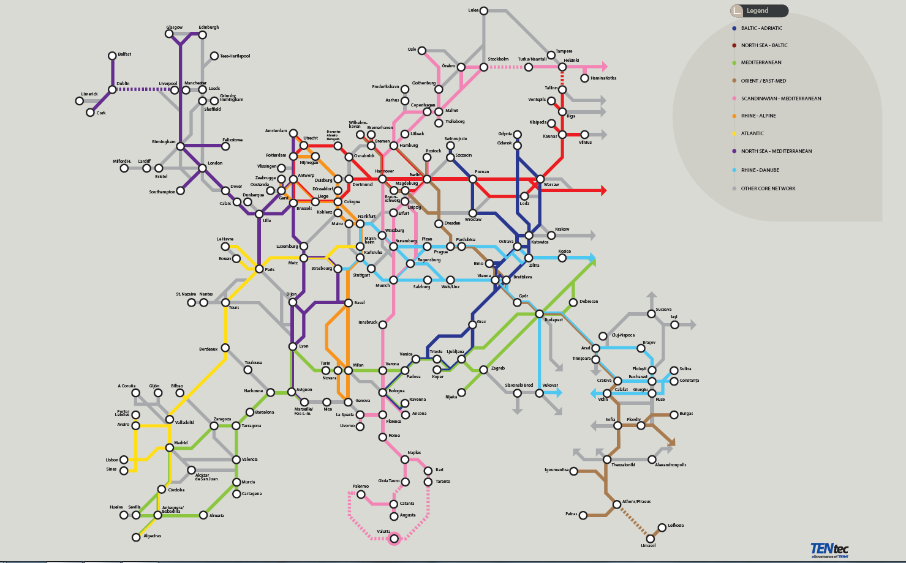
TEN-T Corridors: Europe’s metro

Slide 29
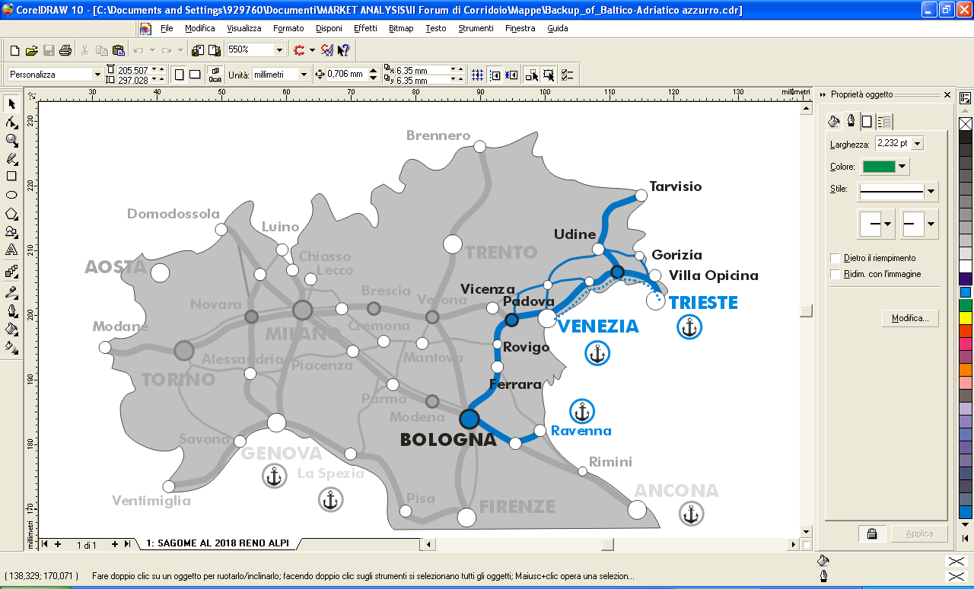
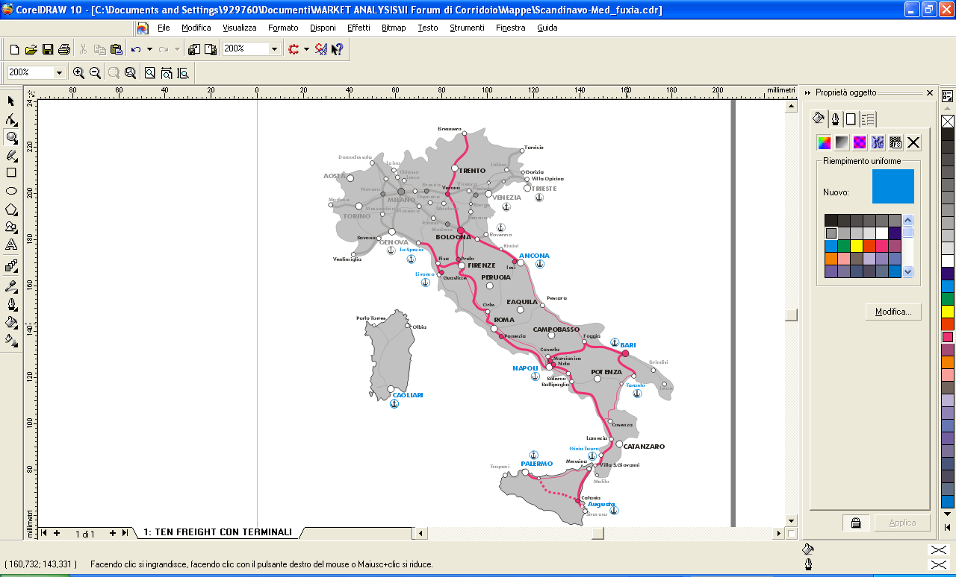
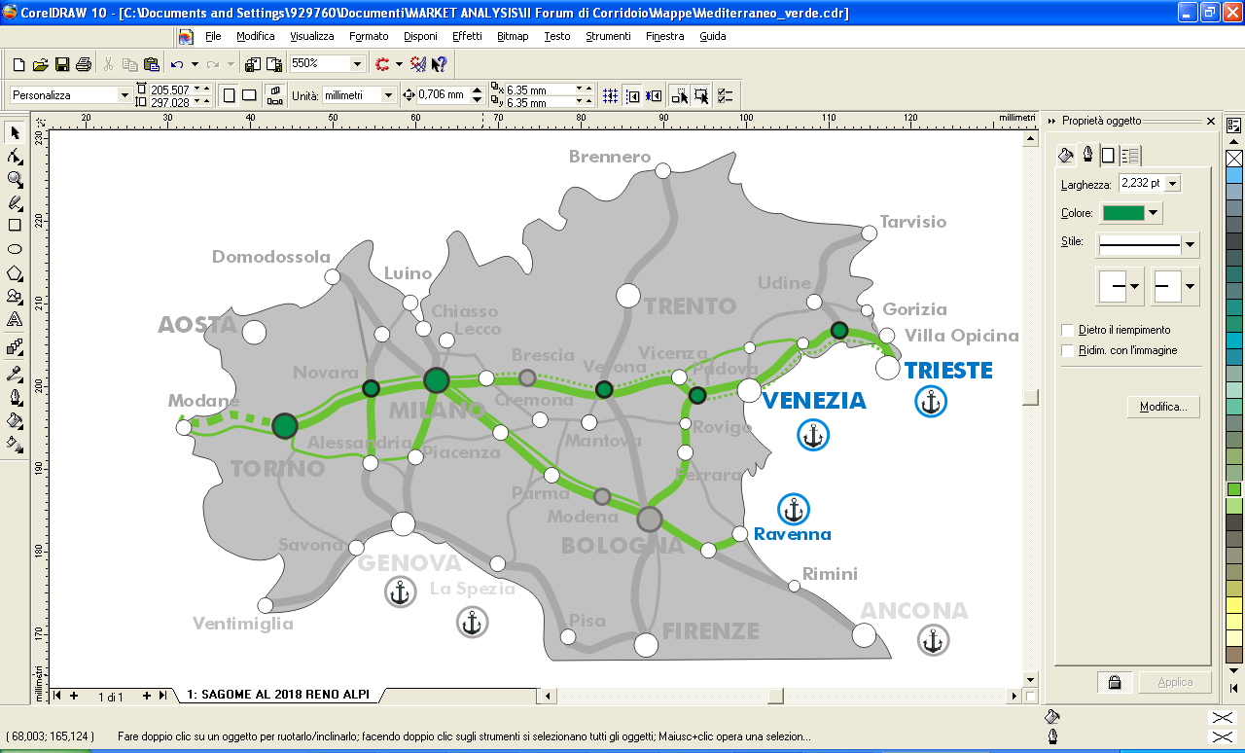

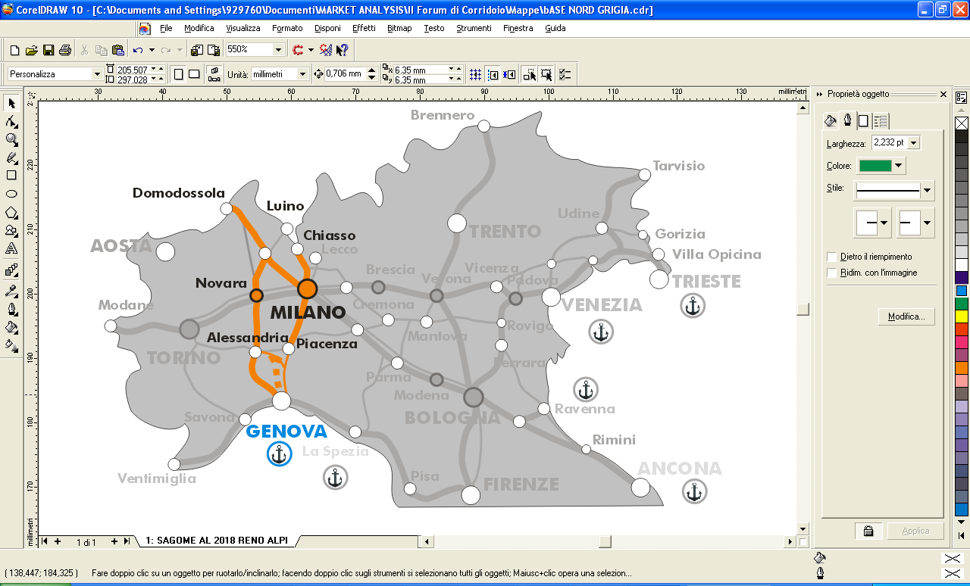
TEN-T cargo Corridors and Italy
Core Corridor Baltico-Adriatico
Core Corridor Scan-Med
Core Corridor Mediterraneo
Core Corridor Reno-Alpi
Core line
Comprehensive line

Slide 30
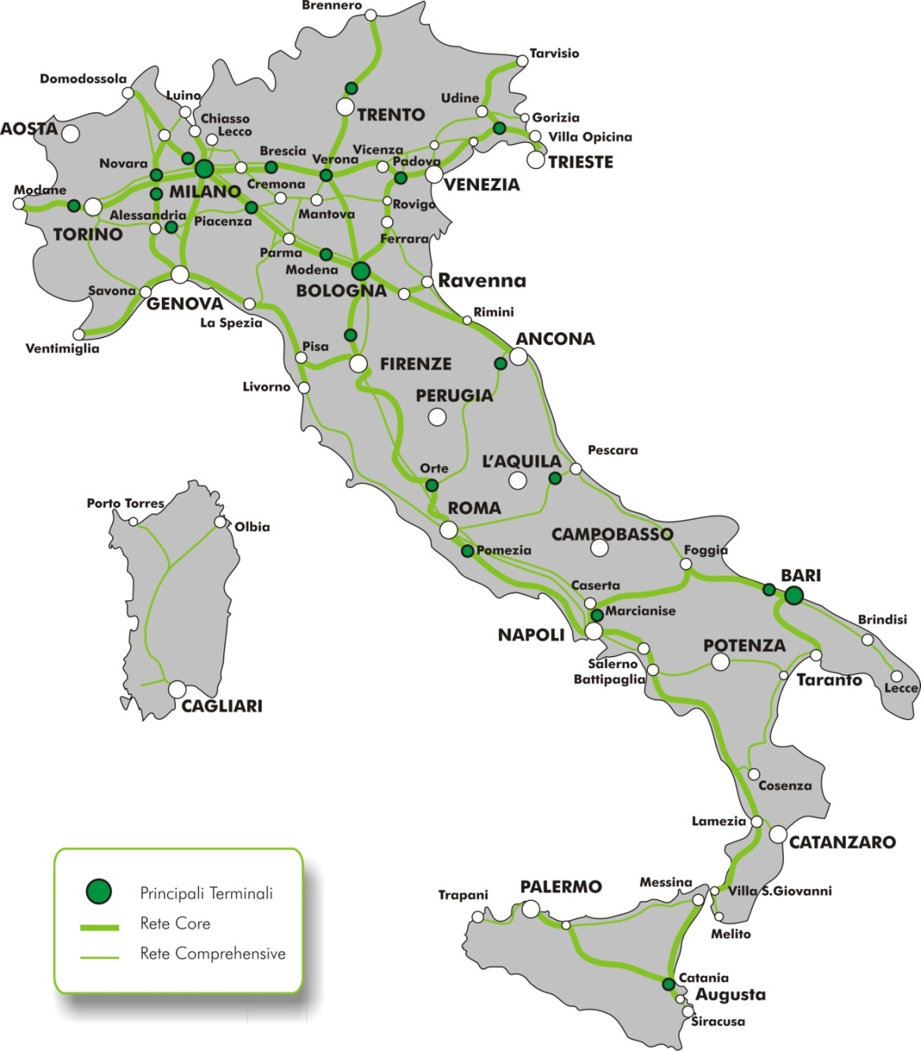
I TEN-T cargo Corridors in Italy and freight terminals
INTERPORTI Prioritari
MILANO
VERONA QE
NOVARA
BRESCIA
PADOVA
MODENA MARZAGLIA
POMEZIA
MARCIANISE
BARI
→La Rete TEN –T complessiva è circa 10.200 km, che corrisponde a circa il 60% della rete RFI
→La Rete TEN-T Core Merci è circa 5.000 km, che corrisponde a circa il 30% della rete RFI

Slide 31
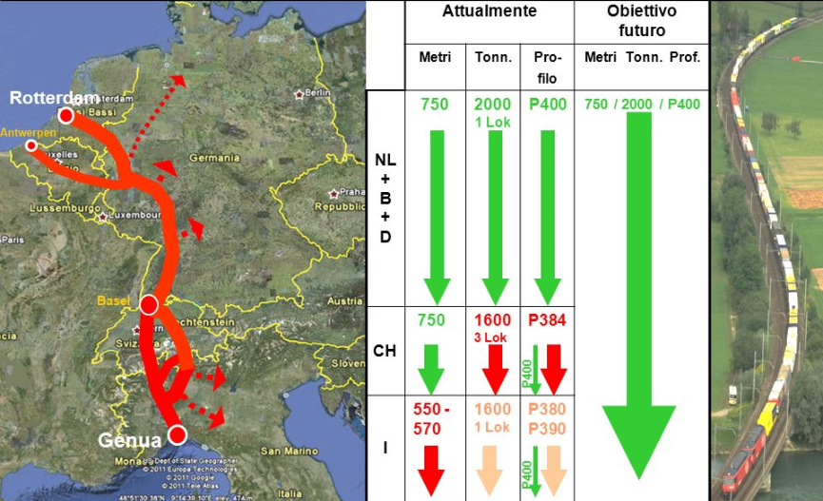
The challenge in the Corridors: longer, heavier and taller trains

Slide 32
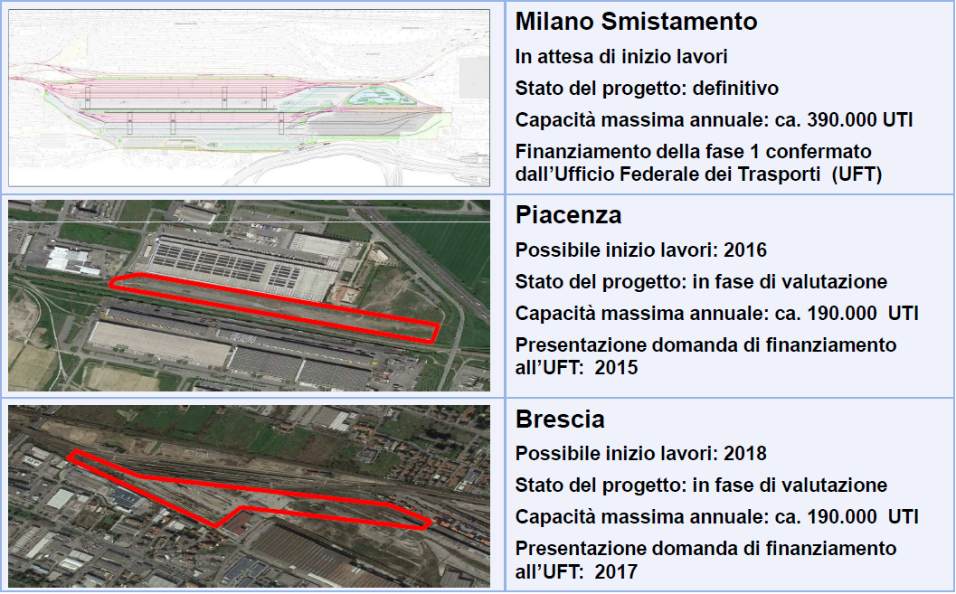
Strategia Terminal: few but good

Slide 33
Conclusions

Slide 34
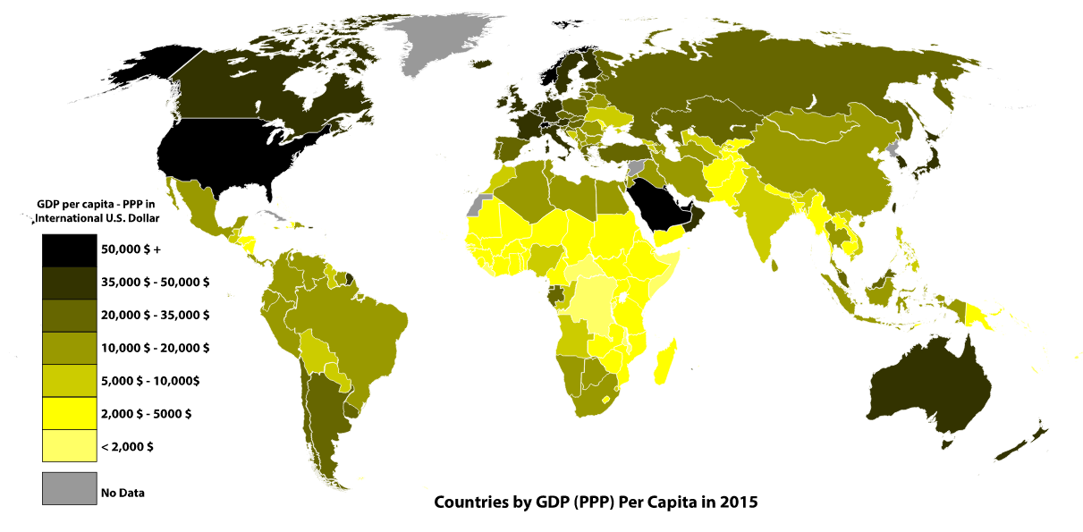
Ranking PIL pro capite source: International Monetary Fund

Slide 35
Some important remarks
There is a close correlation between logistics competences and infrastructures and competitive positioning on the global market
There is a positive correlation between infrastucture (network) investments and node investments leading to local developement
Infrastructure investments have positive returns on the local economy (geographic spillover), provided that both competences and services are present locally *
* Per letteratura scientifica sul tema della geographic spillover, vedi Arbia et al. (2008), SAJARATTANOCHOTE S. and POON J. P. H. Multinationals, geographical spillovers, and regional development in Thailand, Regional Studies 2009; Brasili, Bruno, Saguatti. A Spatial Econometric Approach To Eu Regional Disparities Between Economic And Geographical Periphery

Slide 36
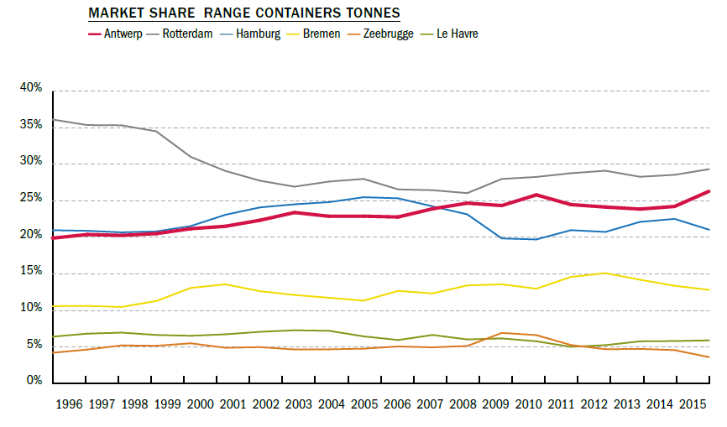
In sintesi

Slide 37
In a nutshell
Hamburg, Rotterdam and Antwerp
Local developement
Integrated approach: managing a manifold of infrastructures sharing coomon objectives
Territorial development
Strong managerial culture

Slide 38
Contact us
European Logistics Association
www.elalog.org
Nicole Geerkens
Executive Officer
nicole.geerkens@elalog.org

